Slide 1


Familial Clustering For Weakly-Labeled Android Malware Using Hybrid Representation Learning
Yanxin Zhang
Supervisor: Yulei Sui
School of Software , Faculty of Engineering and IT

Slide 2

1
Background & Motivation
2
Feature Engineering
3
Hybrid Representation Learning
4
Experimental Results
This Paper – has been submitted to
IEEE Transactions on Information Forensics and Security(TIFS) - Core Ranking A* on 25/03/2019

Slide 3
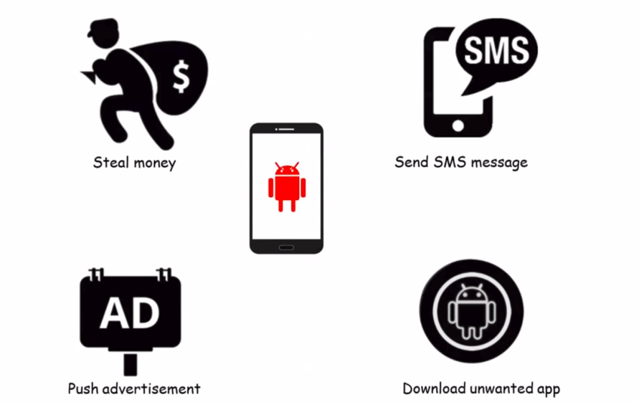
Background and Motivation
Android devices have presented around 80% of all smart phones since 2017
There are 350,000 new discovered malware per day

Slide 4
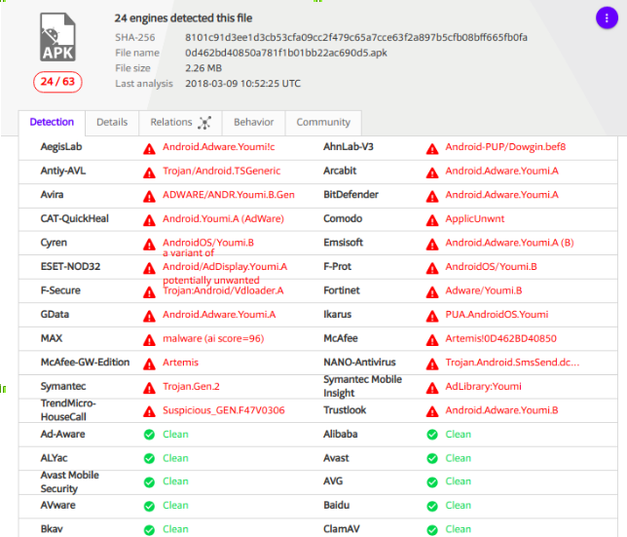
Background and Motivation
Malware Family Identification:
• www.virustotal.com
Challenges:
• AV(AntiVirus) label inconsistencies
• No universal naming conventions
• No Automatic method

Slide 5
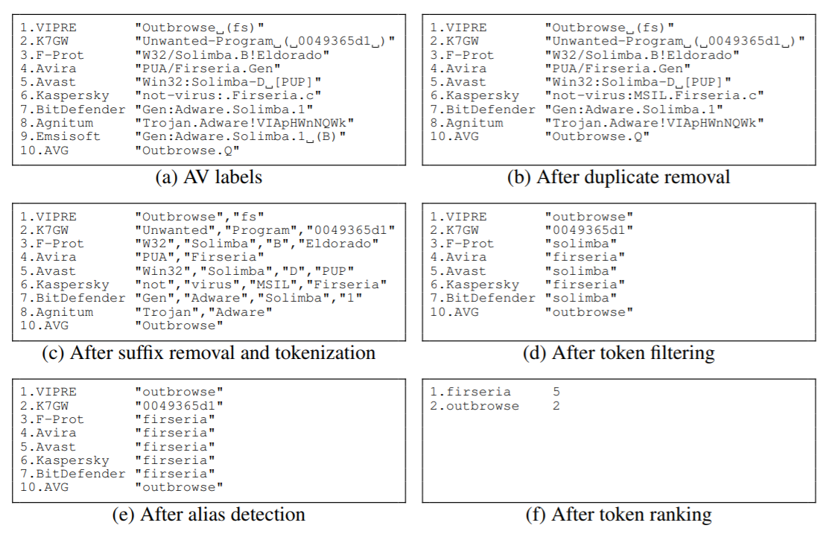
Existing Efforts
Automatic malware label preprocessing and then plurality voting

Slide 6
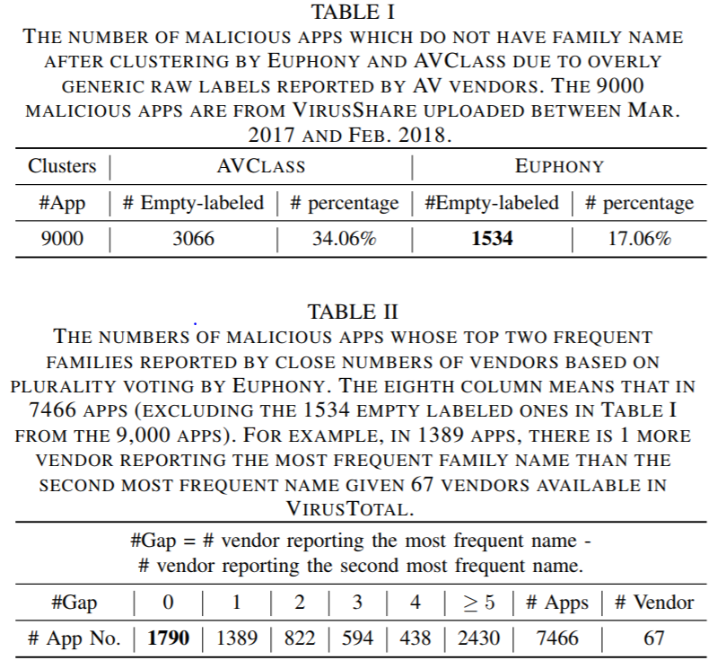
Existing Efforts limitations and observations
AVCLASS and EUPHONY are unable to produce a family name for 33.46% and 18.14% of the total apps(9000 apps).
Plurality voting strategy is also hard to disambiguate inconsistency between two family names reported by close numbers of vendors.

Slide 7
Our Aim & Novelty
• We present a new hybrid representation learning approach to cluster weakly-labeled Android malware.
• We proposed a new representation by successfully preserving heterogeous information including raw labels from AV vendors, meta-info and results from source code analysis.
• Conduct a comprehensive evaluation using widely recognized ground-truths dataset and self collected latest malware

Slide 8
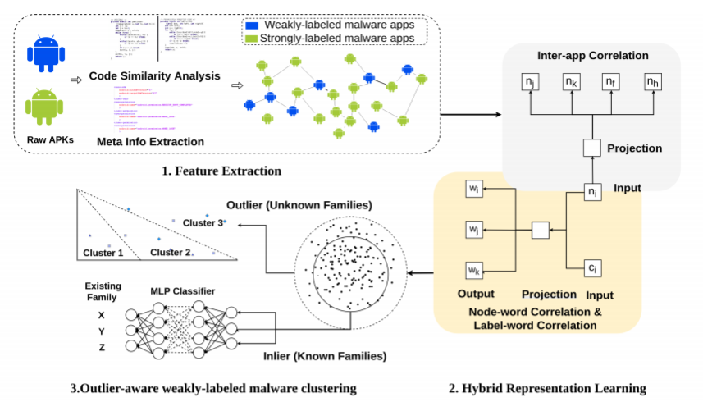
Framework Overview

Slide 9
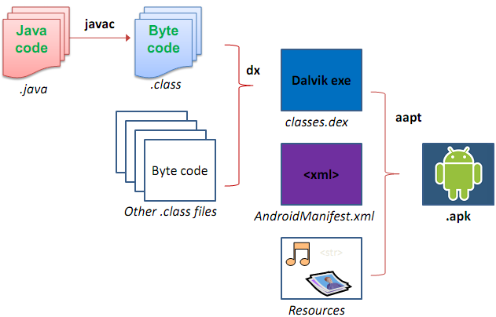
Anroid Package Information (APK)
Code similarity analysis:
• Classes.dex
Meta info analysis:
• AndroidManifest.xml :
a. Version Code
b. Application Label
etc

Slide 10
Anroid Package Information (APK)
Code similarity analysis:
• Classes.dex
Meta info analysis:
• AndroidManifest.xml :
a. Version Code
b. Application Label
etc

Slide 11
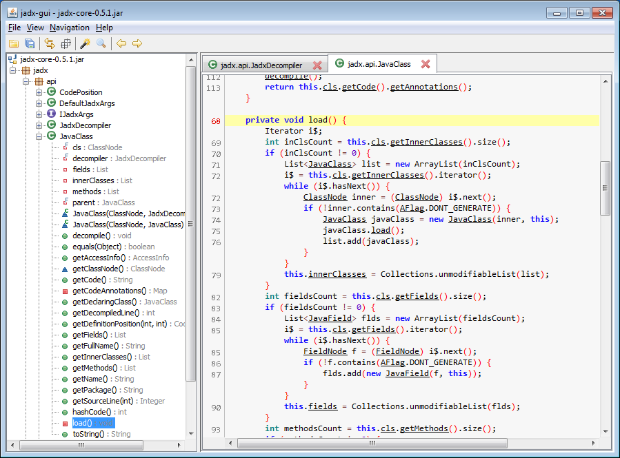
Android Package Information(APK) – Source code
APK files
decompilation:
Dex-2-jar
Jadx-gui

Slide 12
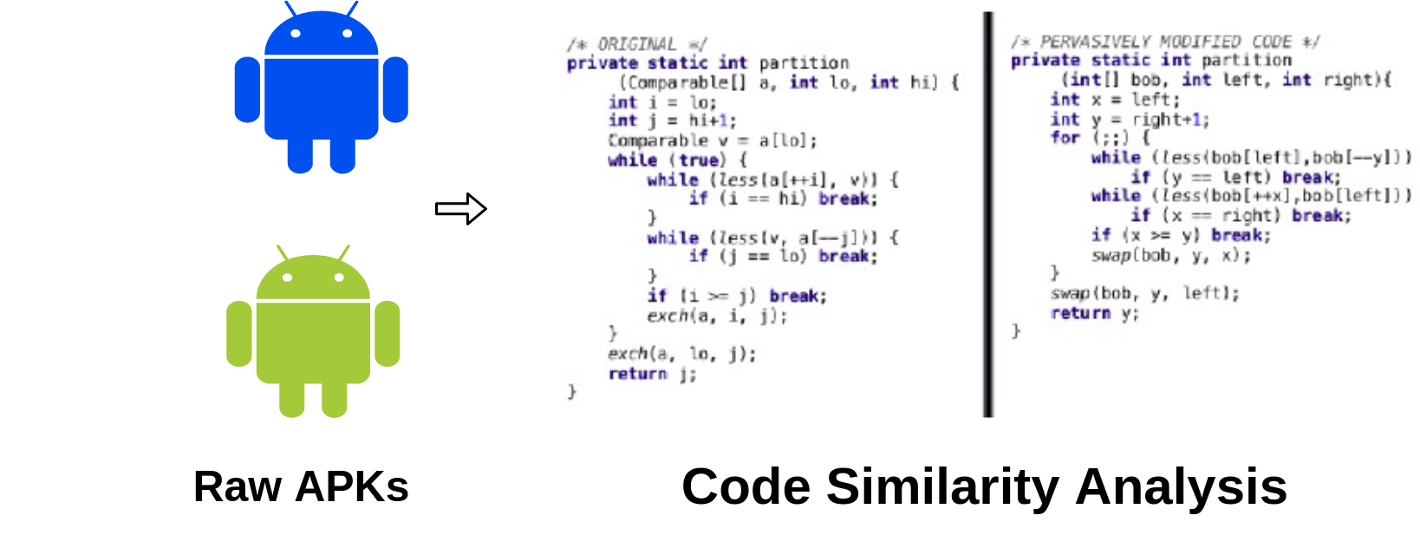
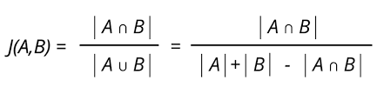
Feature Extraction – Code Similarity
Jaccard Similarity Score

Slide 13
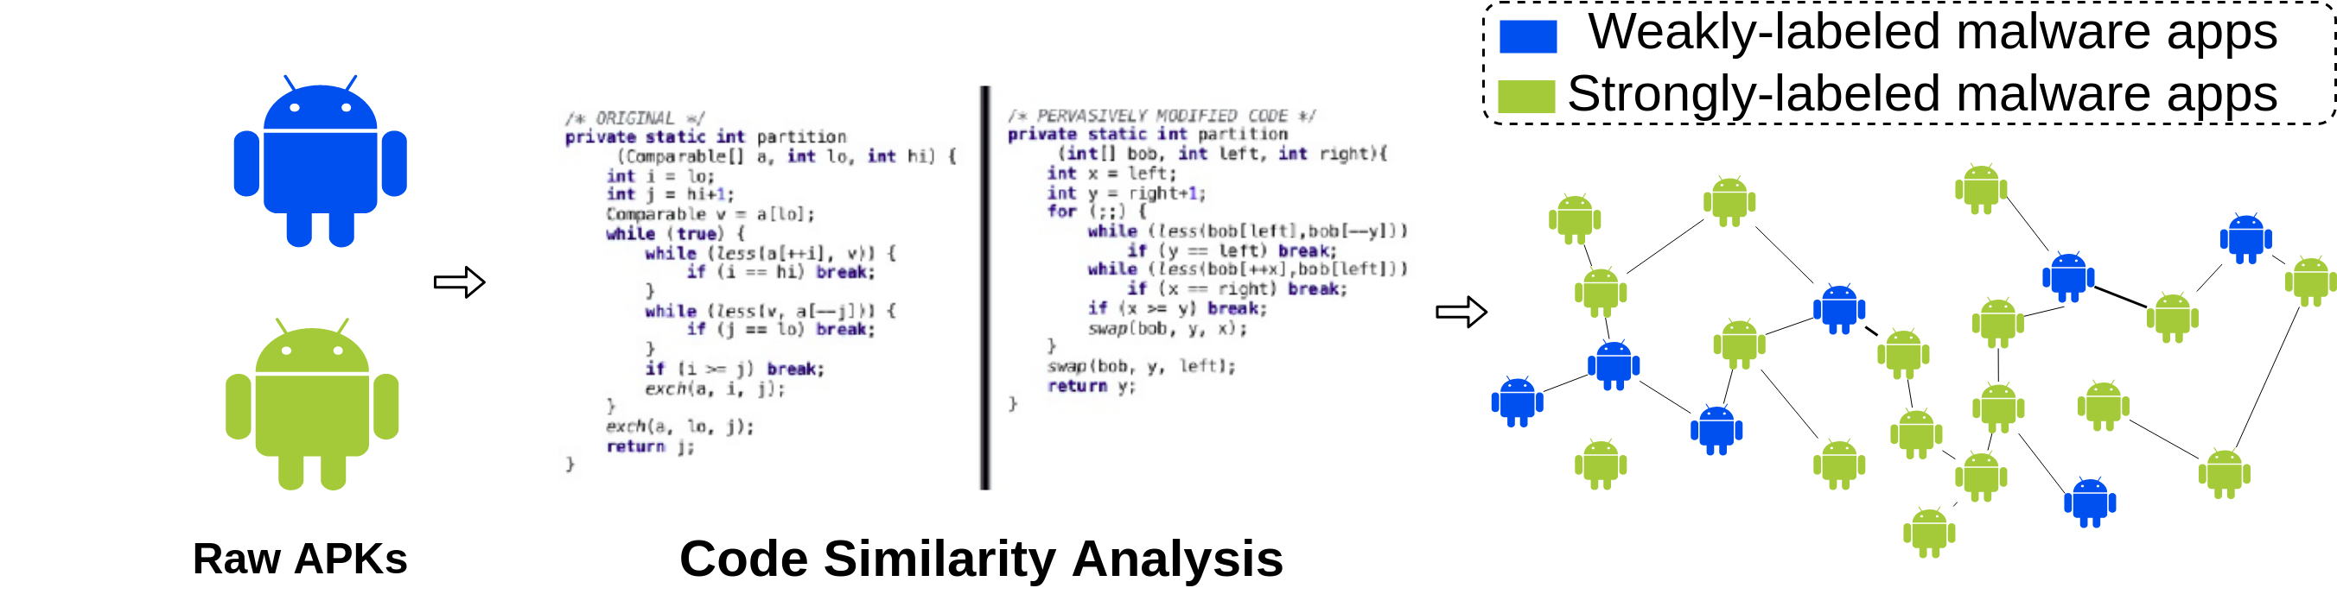
Feature Extraction – Code Similarity
Jaccard Similarity Score

Slide 14
Anroid Package Information (APK) – Android Manifest

Slide 15
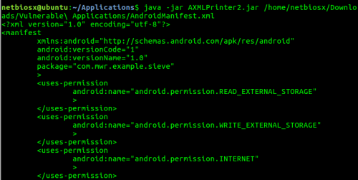
Feature Extraction – Meta Info
Meta Info:
•Package Name
•Version Code
•Application Label
•Launcher Activity
•Permission
•etc

Slide 16
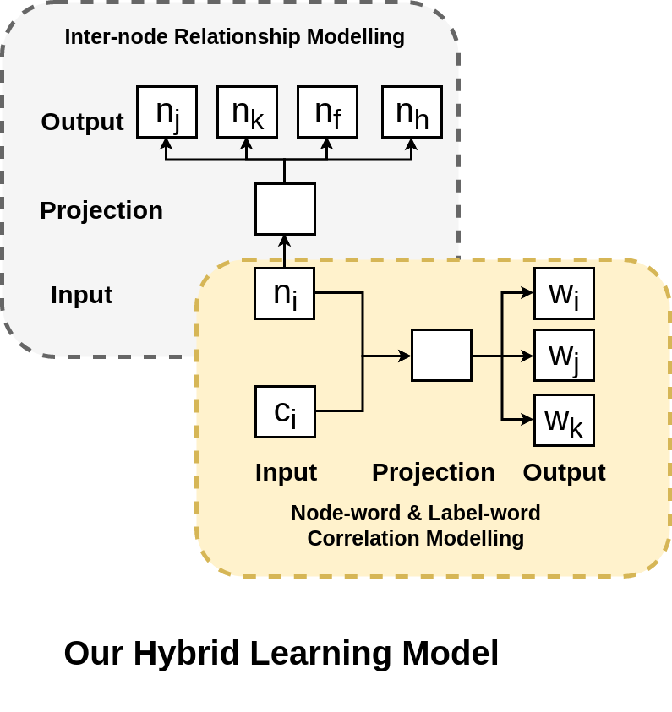
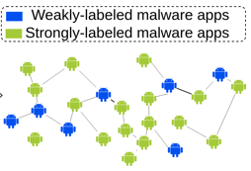
Hybrid Representation Learning

Slide 17
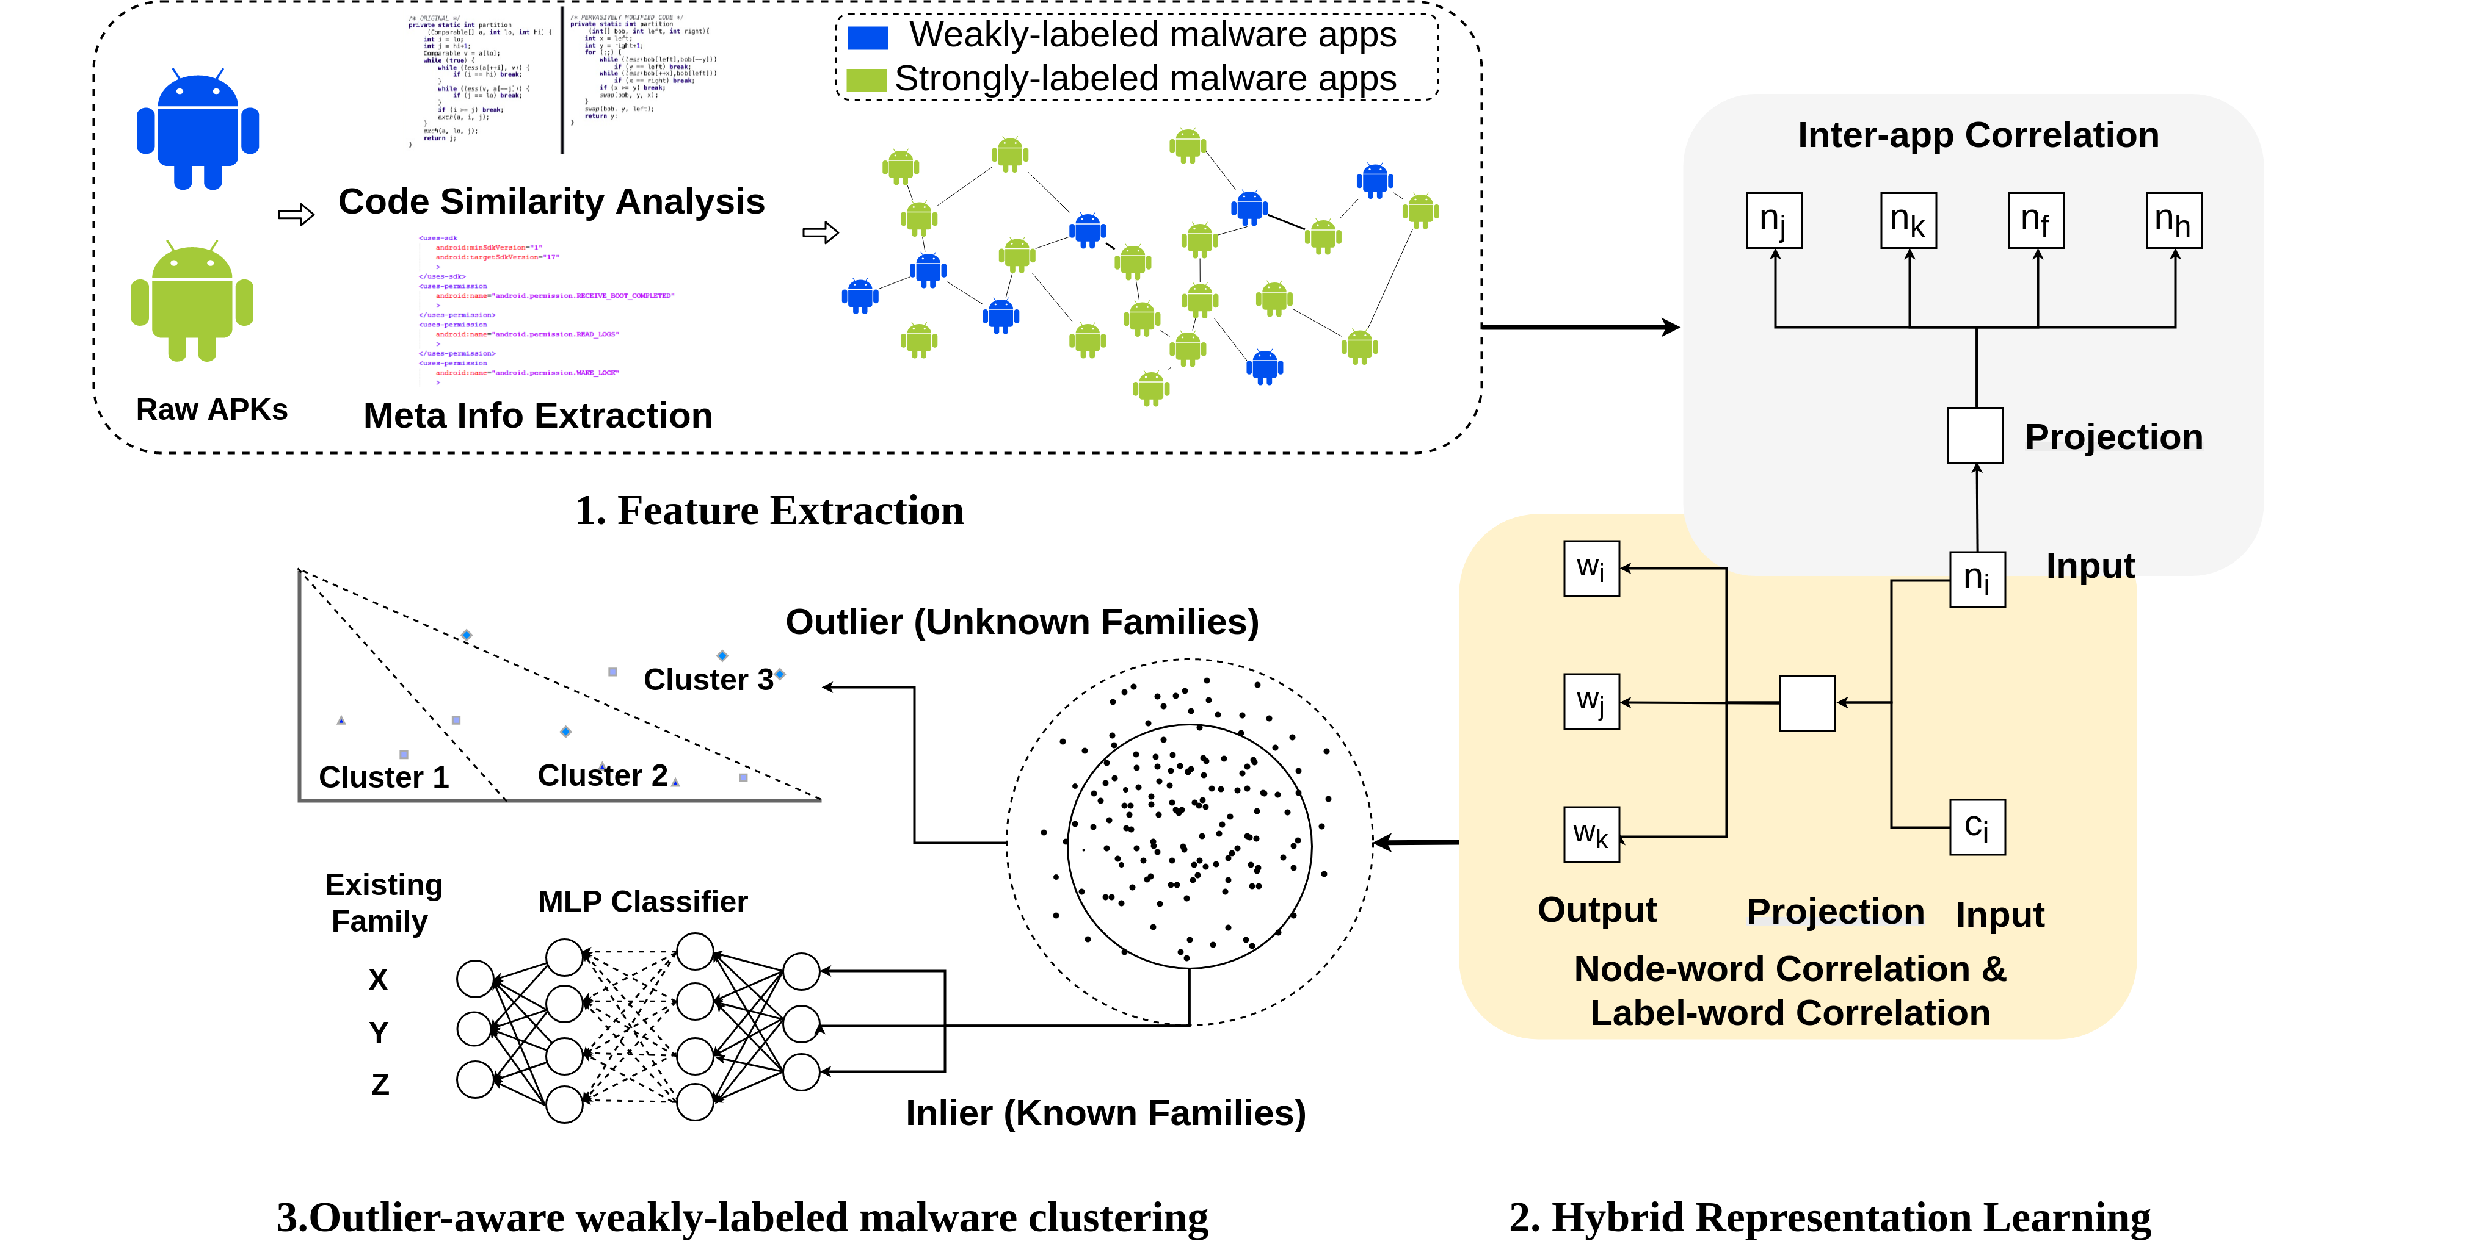
Outlier-aware weakly-labeled malware clustering

Slide 18
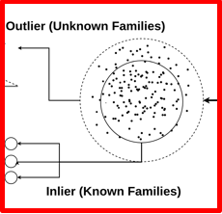
Partition malware into outlier and inlier
Topological Anomaly Detection (TAD)
The technique is essentially a density based outlier detection algorithm that, instead of calculating local densities, constructs a graph of the data using nearest neighbours.

Slide 19
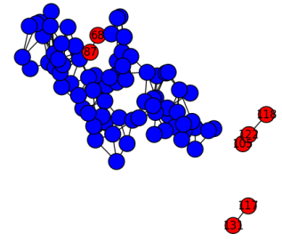
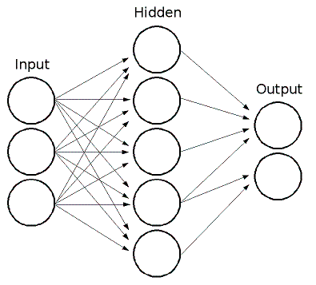
Identify malicious family for malware in inlier

Slide 20
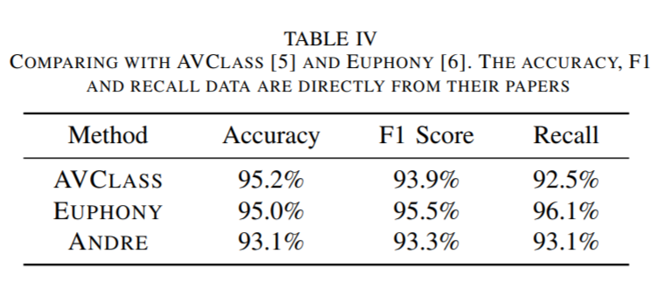
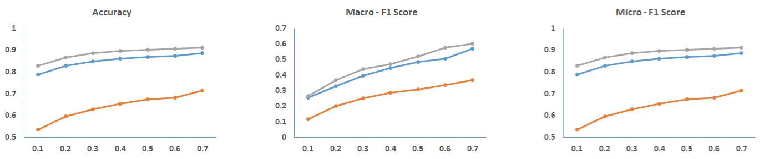
Evaluation – Compare with State-of-the-art works & baseline methods
● DeepWalk, ● Doc2Vec, ● ANDRE

Slide 21
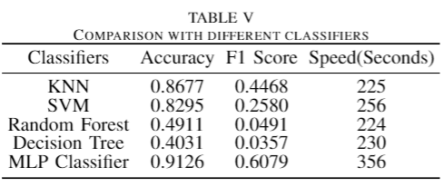
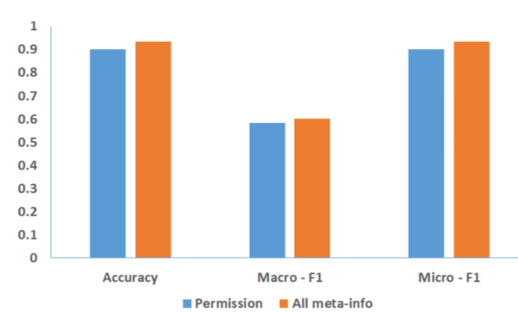
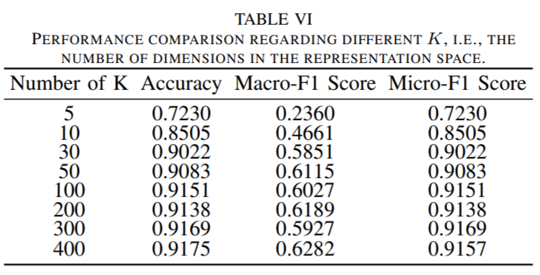
Evaluation – Compare with State-of-the-art works & baseline methods

Slide 22
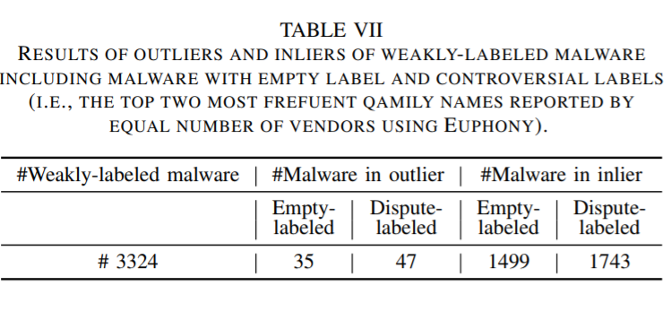
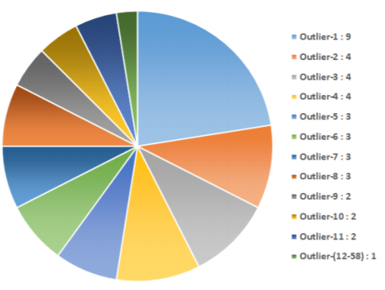
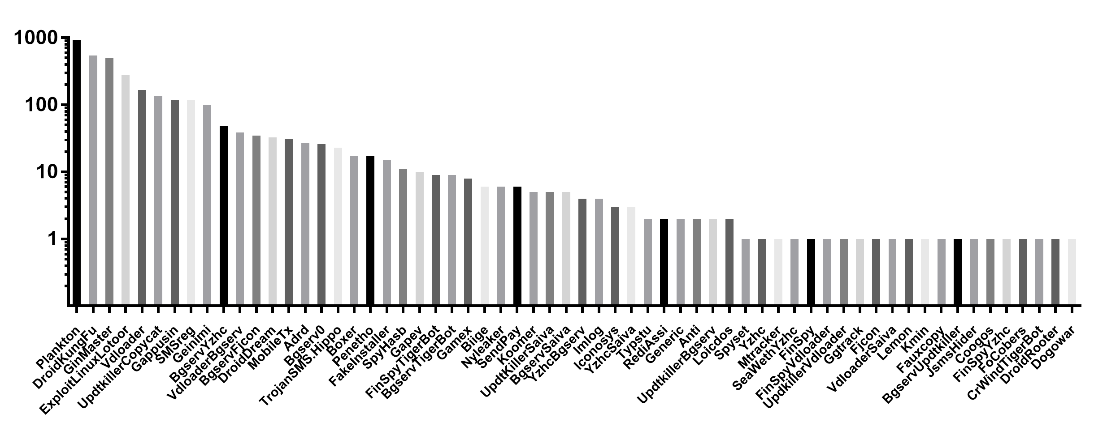
Evaluation – Malware in outlier & inlier

Slide 23
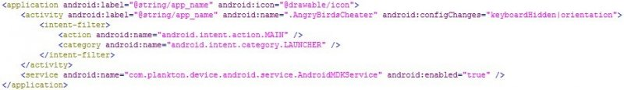
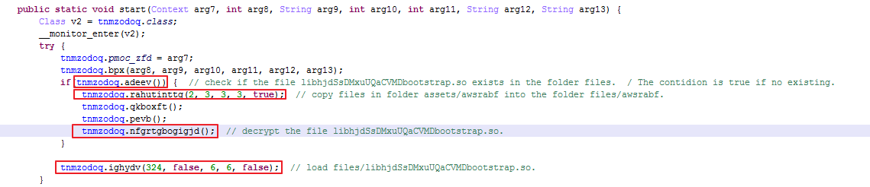
Evaluation – Manual Estimation
Evaluation – Manual Estimation
AndroidManifest.xml – risky meta information
Target payloads to understand malicious behavior

Slide 24
Future Work
Study of Repackaging Malware for Evading Machine-Learning Detection
A Survey on Android malware clustering and classification against obfuscation and adversarial malware

Slide 25

Thanks For Your Listening

